Slide 1
Introduction to Economics- Definition and Scope
By
Dr. Mahendra Parihar
Associate Professor,
MPSTME, NMIMS Mumbai

Slide 2
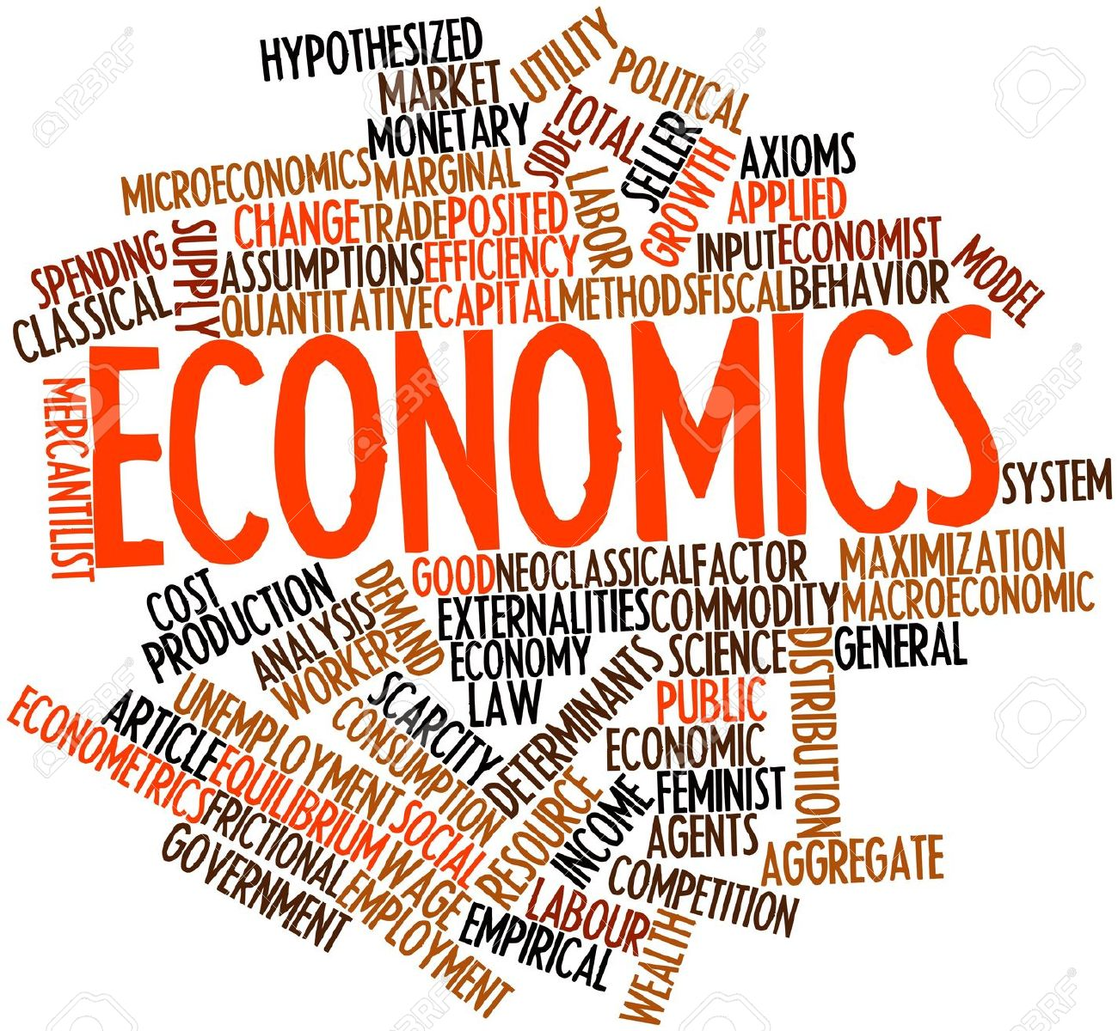
Economics is a social science concerning man’s efforts to earn a living.
The word “economics” has been derived from Greek words ‘oikos’ meaning ‘a house’ and ‘nemein’ referring to ‘manage’. Thus, economics means managing a household with limited funds.

Slide 3
Definitions:
Adam Smith (Father of Economics): ‘as an enquiry into the nature and causes of wealth of Nations’. Thus, according to Adam Smith, Economics is a science of Wealth.
Alfred Marshall: ‘economics on the one side the study of wealth; and on the other and most important side, a part of the study of man. It studies the wealth in relation to human beings’.
Lionel Robbins: “Economics is the science which studies human behavior as a relationship between ends and scarce means which have alternative uses”. Thus the emphasis is on scarcity of means and multiplicity of ends.

Slide 4
Over the last six decades the study of economics has expanded to include a vast range of topics:
prices of various factors
changes in the financial markets
the allocation of income to different income groups
the implications of government expenditure and taxation policy
growth patterns in developing countries
Thus, economics includes two important ideas: that goods are scarce and that society must use its resources efficiently.

Slide 5
ECONOMICS: Micro and Macro
Ranger Frisch has classified economics into two broad categories Microeconomics and Macroeconomics.
The term ‘micro’ is derived from the Greek word ‘mikros’ which means ‘small’ and the term ‘macro’ has been derived from the Greek word ‘makros’ which means ‘large’.
Microeconomics deals with behaviour of individuals, for example, that of a consumer or a producer or a market. Micro means a millionth part i.e. very small part or a single unit. In contrast, macroeconomics is concerned with the behaviour of aggregates, for example, national income, agricultural output, industrial output, general price index, total employment, unemployment, balance of trade, growth rate of an economy, etc.

Slide 6
Macroeconomics vs. Microeconomics
MICROECONOMIC QUESTION | MACROECONOMIC QUESTION
Go to business school or take a job? | How many people are employed in the economy as a whole?
What determines the salary offered by Citibank to Mr. ABC, a new NMIMS MBA-Tech? | What determines the overall salary levels paid to workers in a given year?

Slide 7
Macroeconomics vs. Microeconomics
MICROECONOMIC QUESTION | MACROECONOMIC QUESTION
What determines the cost to NMIMS of offering a new course? | What determines the overall level of prices in the economy as a whole?
What government policies should be adopted to make it easier for low-income students to attend college? | What government policies should be adopted to promote full employment and growth in the economy as a whole?
What determines whether NMIMS opens a new campus in Mount Abu-Rajasthan? | What determines the overall trade in goods, services and financial assets between the US and the rest of the world?

Slide 8
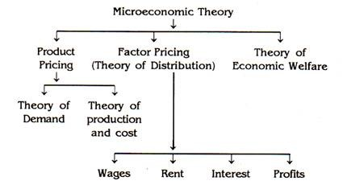
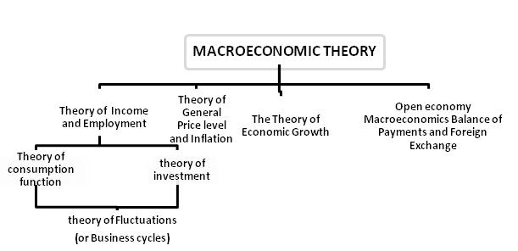
Subject Matter:

Slide 9
The Economic Problem: Scarcity, Choice, and Opportunity Cost
Human wants are unlimited, but resources are not.
The basic questions must be answered in order to understand an economic system:
What to produce
How to produce
For whom to produce
Where to produce
etc…

Slide 10
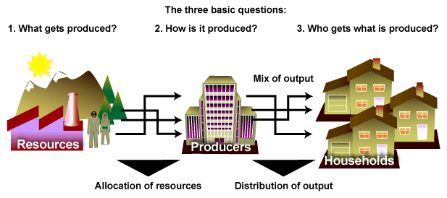
Scarcity, Choice, and Opportunity Cost
Every society has some system or mechanism that transforms that society’s scarce resources into useful goods and services.

Slide 11
PRODUCTION POSSIBILITY CURVE/ FRONTIER:
Prof. Paul Samuelson introduced the concept of Production Possibility Curve (PPC).
According to him: At any point of time a country can produce only a certain quantity of goods and services with its limited resources; example of so much of consumer goods and so much of capital goods; making full use of country’s available resources. Further, more of goods cannot be produced without giving up some of another goods.
ASSUMPTIONS:
Only two goods X and Y are produced.
The available resources are fully employed.
The resources are fixed in quantity. But they are reallocated from the production of one commodity to that of the other.
The state of technology or method of production is given and remains constant.
The time period considered is short-run.
The Production Possibility Frontier:
The production possibility frontier (PPF) is a graph that shows all of the combinations of goods and services that can be produced if all of society’s resources are used efficiently.

Slide 12
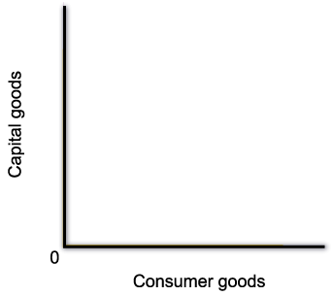
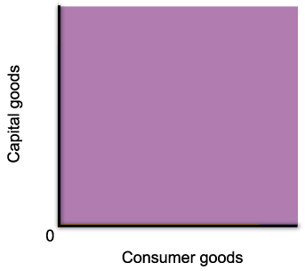
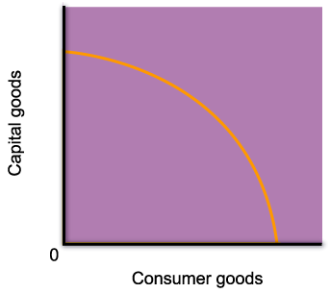
The Production Possibility Frontier
The production possibility frontier curve has a negative slope, which indicates a trade-off between producing one good or another.

Slide 13
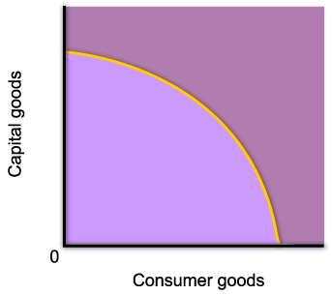
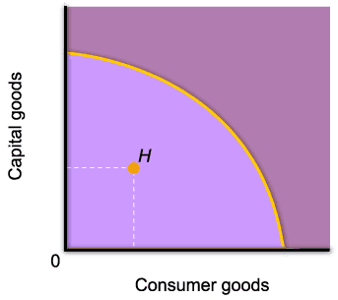
The Production Possibility Frontier
Points inside of the curve are inefficient.
At point H, resources are either unemployed, or are used inefficiently.

Slide 14

The Production Possibility Frontier
Point F is desirable because it yields more of both goods, but it is not attainable given the amount of resources available in the economy.

Slide 15

The Production Possibility Frontier
Point C is one of the possible combinations of goods produced when resources are fully and efficiently employed.

Slide 16



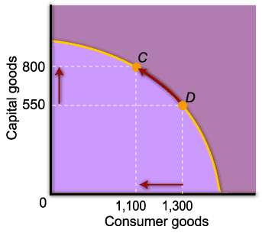
The Production Possibility Frontier
A move along the curve illustrates the concept of opportunity cost.
From point D, an increase the production of capital goods requires a decrease in the amount of consumer goods.

Slide 17
Economic Growth
Economic growth is an increase in the total output of the economy. It occurs when a society acquires new resources, or when it learns to produce more using existing resources.
The main sources of economic growth are capital accumulation and technological advances.

Slide 18
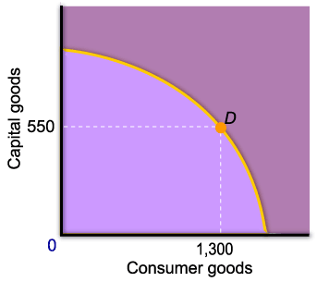
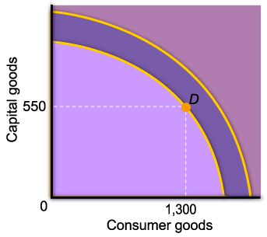
Economic Growth
Outward shifts of the curve represent economic growth.
An outward shift means that it is possible to increase the production of one good without decreasing the production of the other.

Slide 19
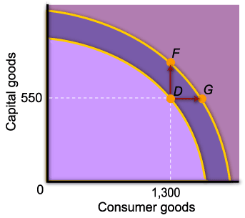
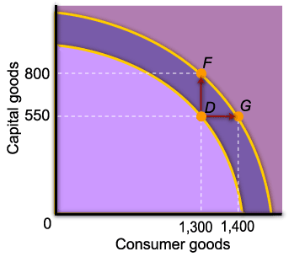
Economic Growth
From point D, the economy can choose any combination of output between F and G.

Slide 20
Types of Economic System:
Types/Forms:
Capitalism (Market Economy)
Socialism (Planned economy)
Mixed (Capitalism + Socialism)

